Slide 1
DELETED DATA RECOVERY FROM USB

Slide 2
Tools Used
FTK Imager ( Forensic imaging of USB drive )
Autopsy ( Analysis and recovery of deleted files )
Step 1: Acquire USB Image using FTK Imager
Connect USB to your PC
Open FTK Imager and go to files -> Create disk image
Select physical drive , then choose USB from list
Choose image type prefer ( RAW dd or E01 format )

Slide 3
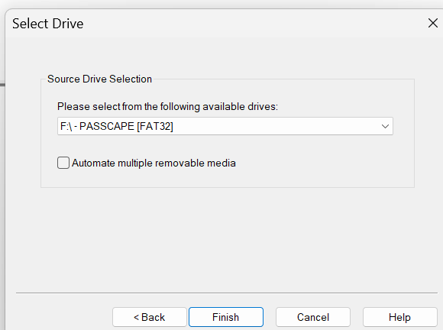
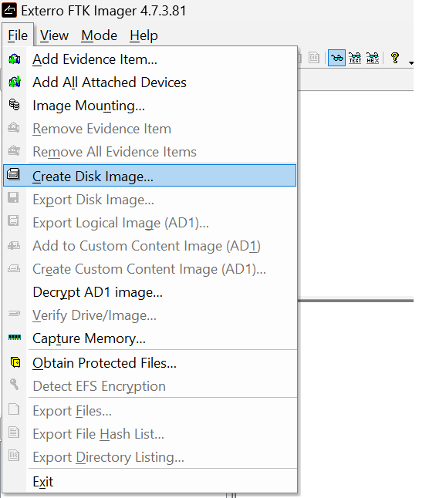

Slide 4
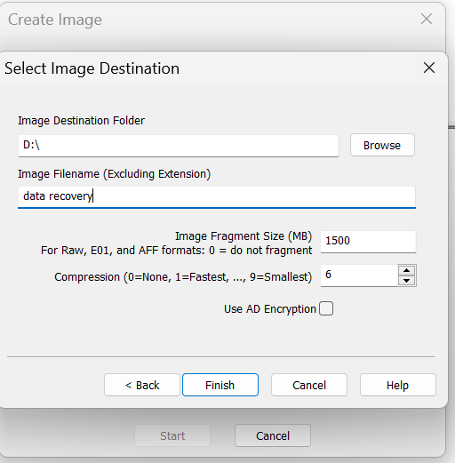
Select destination folder and name the image file
Click finish and let FTK imager to create a file
By following forensic procedure make 3 copies of
image file
Chek integrity by using hash calculator
Then work on 3rd copy of image

Slide 5
Step 2: Analyze and Recover Deleted Files using Autopsy
Launch autopsy and create a new case
provide case name , number and examiner details
Click Add data source ->> Choose disk image or vm file
Browse and load image file created by FTK Imager
Select Ingest modules like
file type identification , deleted files , data carving
Click next and wait for analysis to complete

Slide 6
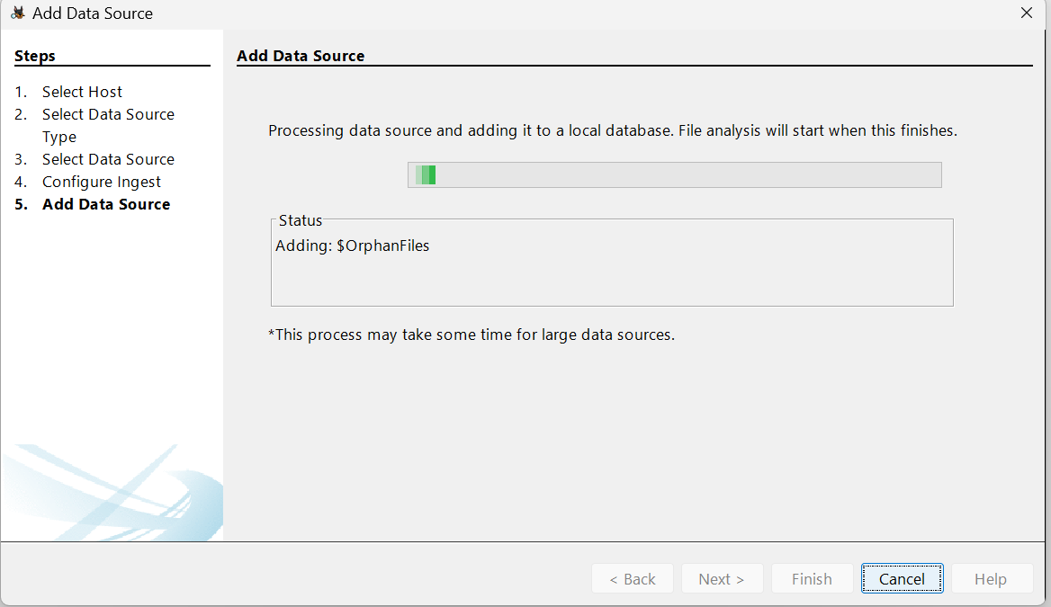
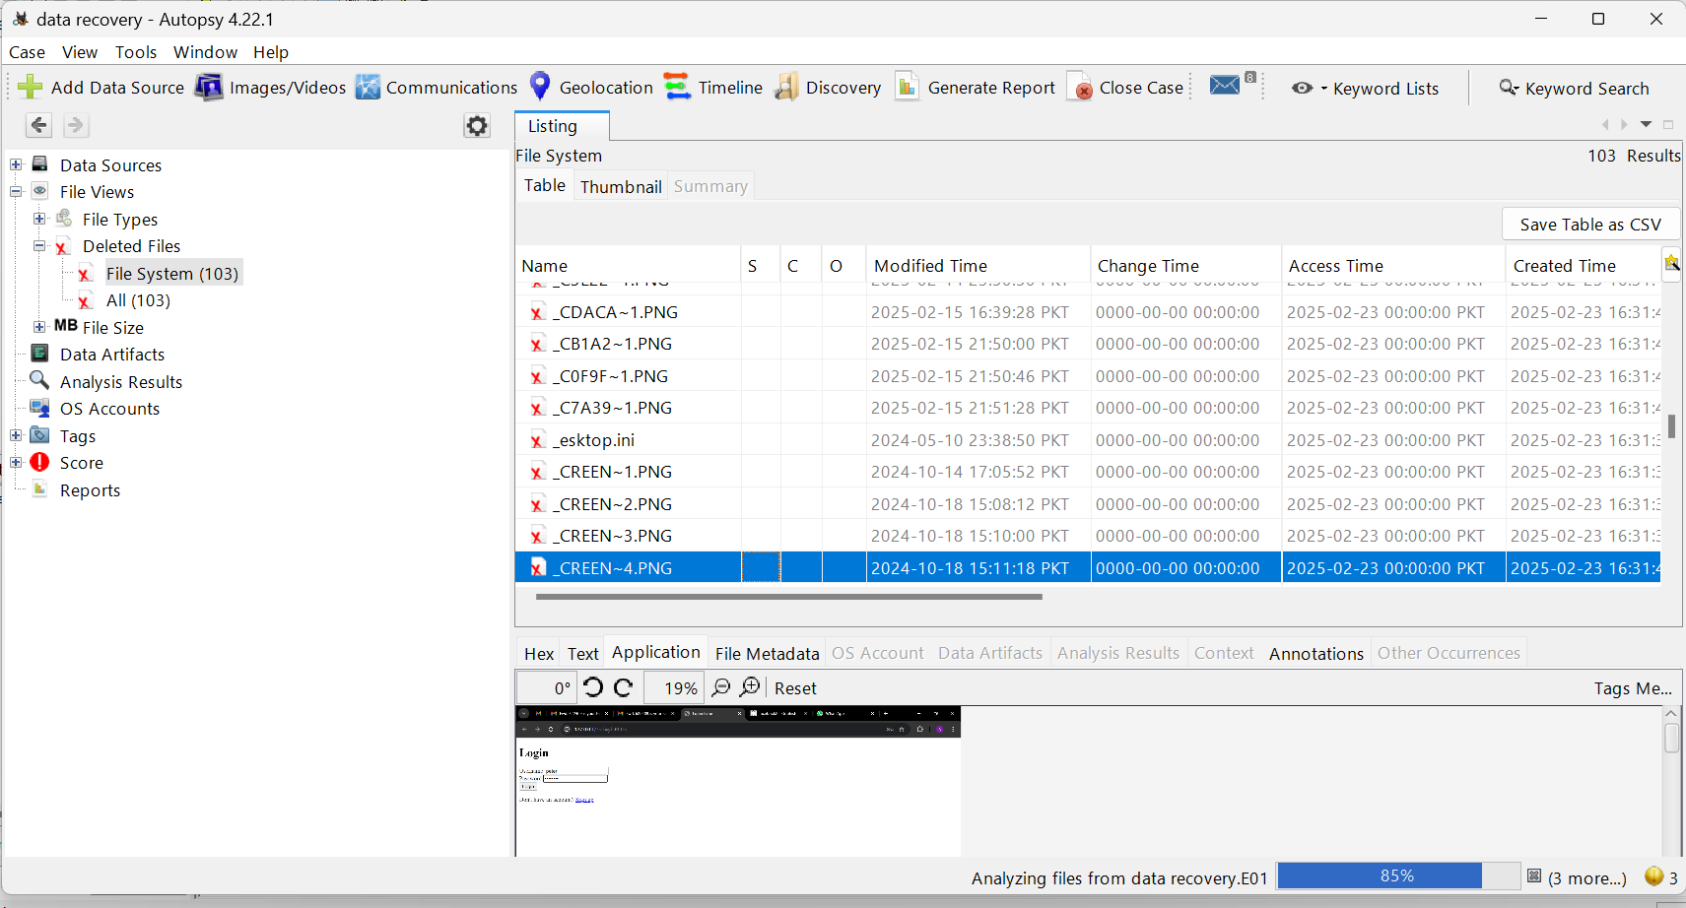

Slide 7
Recovering deleted files
Go to ‘deleted file’ under the file types and view section
You can preview content , file names and timestamps
Right click on any deleted file and select Extract to save it

